Slide 1

City of Mesa
FY 2017/18
Utility Departments Rate
Recommendations
and Enterprise Fund Summary
City Council
April 13, 2017
Presented by the Office of Management and Budget

Slide 2

Enterprise Operations
  Each utility is operated as a separate business center
  Combined Ending Reserve Balance adheres to the adopted financial policy of at least 8-10% over the forecast period
  Reserve balance is used to smooth rate adjustments year-to-year
  Reserve balance can be used to phase in new programs or changes in operations

Slide 3

Revenue Targets
  Forecasted expenses are compared with forecasted revenues based on current rates and projected customer growth
  In FY 2017/18, the following increases in revenues are needed to accommodate the estimated costs
Utility | Revenue
Electric | $180,000
Natural Gas | $467,000
Water | $4,491,000
Wastewater | $2,846,000
Solid Waste* | $1,490,000
Total | $9,474,000
* Green and Clean Revenue not included

Slide 4

Rate Adjustment Implementation
  Methods of implementation of rate adjustments can vary from year to year based on needs and goals of the individual utilities
  Impact on individual customers can vary based on the method of implementation and the customer consumption of services
4

Slide 5
Proposed Changes to Reach Revenue Targets
 | Prior Year FY 2017/18 Projection | FY 2017/18 Proposal
Electric | $1.50 | $1.25
Gas | $1.00 | $0.75
Water | 4.5% | 3.5%
Wastewater | 5.0% | 4.0%
Solid Waste | 4.0% | 3.5%

Slide 6
Average Residential Customer Impact
Utility Monthly Annual
Solid Waste $0.97 $11.64
Water $1.57 $18.84
Wastewater $1.12 $13.44
Total $3.66 $43.92
Electric $1.25 $15.00
Natural Gas $0.75 $9.00

Slide 7
Rate Adjustment Forecast for the Next Five Years

Slide 8
Enterprise Fund Reserves

Slide 9
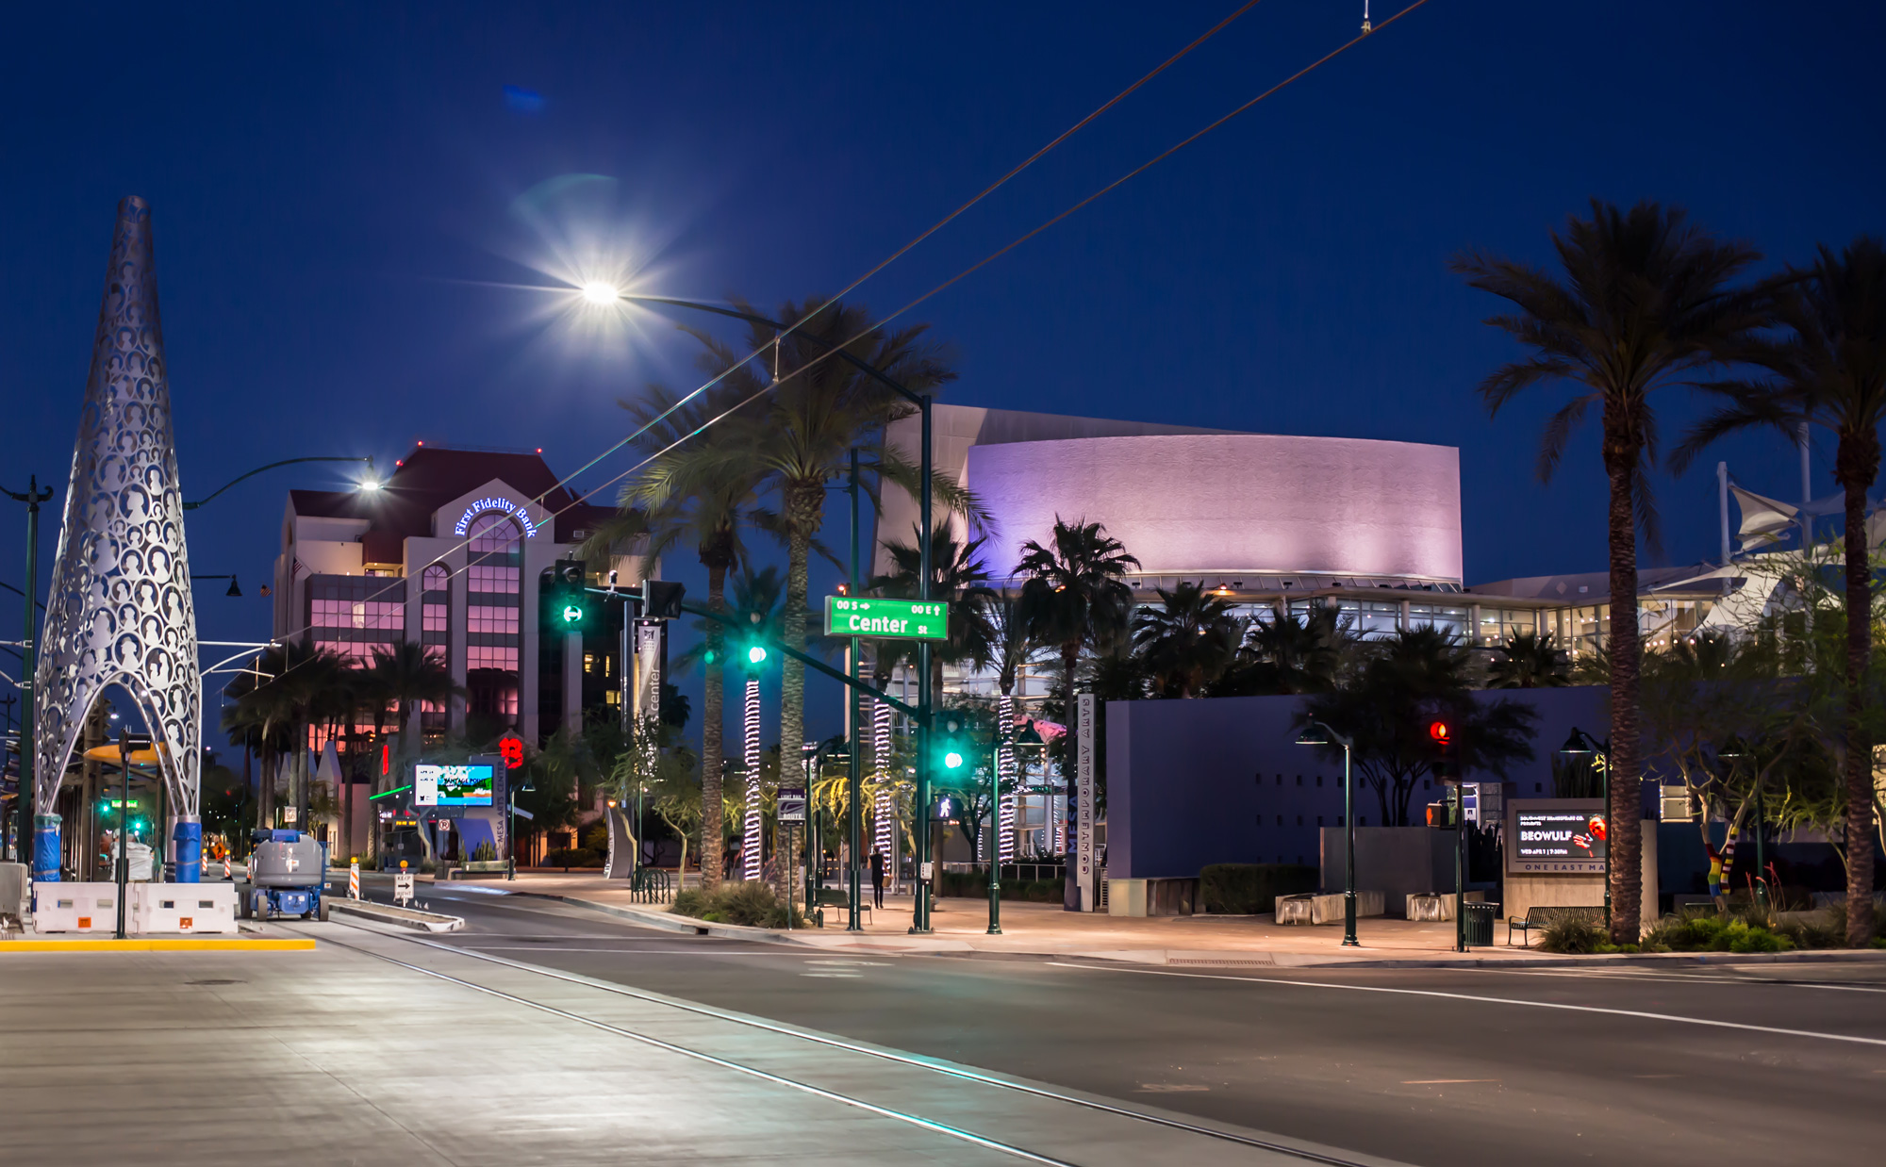
Downtown Small Business Attraction Utility Rates

Slide 10
Downtown Small Business Attraction Utility Rates
Designed to attract new City utility customers to downtown Mesa and increased economic activity
Offers reduced electric and water rates (25% reduction)
The incentive will last 3 years
Includes annual financial cap of $75,000 for electric and $10,000 for water

Slide 11
Downtown Small Business Attraction Utility Rates
Eligibility Requirements
Small business as defined by U.S. Small Business Administration
Located within adopted Town Center RDA and Central Business District
Maintain minimum and maximum utility consumption
    Electric: 12,000 – 800,000 kWh annually
    Water: 10,000 – 200,000 gallons annually
Create and maintain at least two full time equivalent positions

Slide 12
Schedule for FY 2017/18 Utility Rate Consideration
May 8
Introduce Utility Rate Ordinances
May 22
City Council Action on Utility Rates
July 1
Effective date for Utility Rate changes

Slide 13


