Slide 1
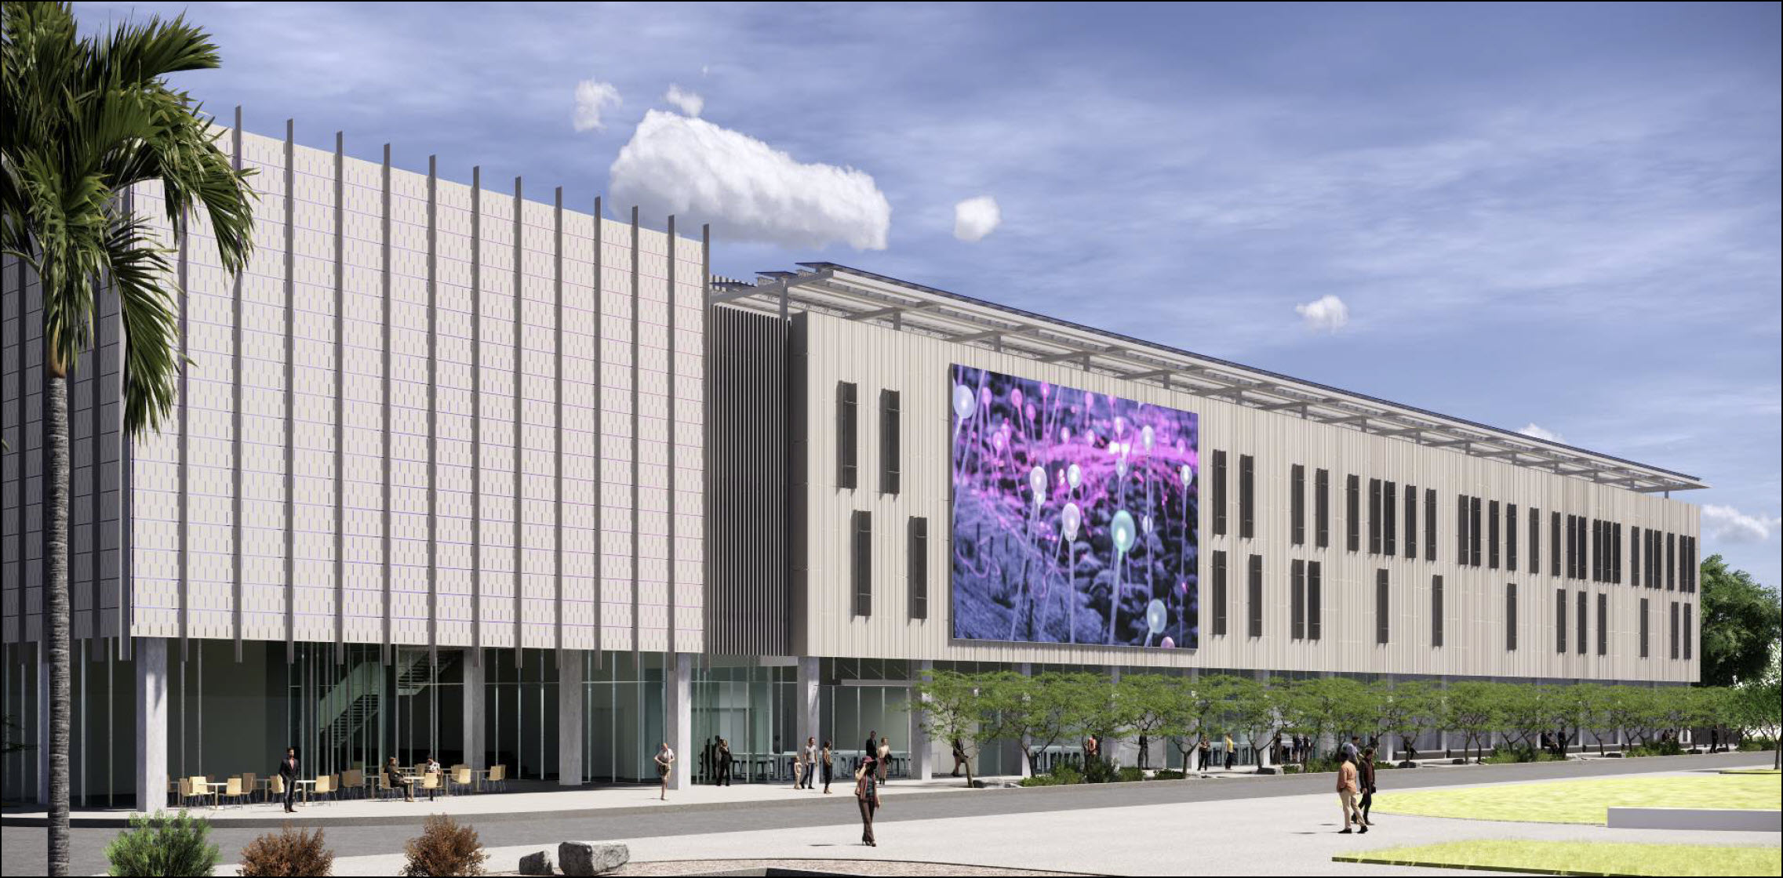
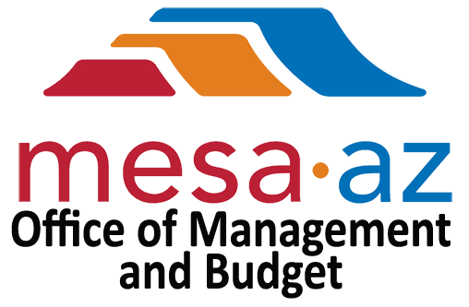
Adoption of FY 21/22 Capital Improvement
Program Budget
City Council
Study Session
5/13/2021
Brian A. Ritschel | Management & Budget Assistant Director
Justin Stadt | Management & Budget CIP Coordinator
Notes:
Susanne provided other renderings. All look good to me.

Slide 2
Capital Improvement Program Process
City Council annually approves a Five-Year Capital Program (Program) per the City Charter
Projects and timing of projects may change from year to year in the Program based on City priorities and available funding

Slide 3
Capital Improvement Program Process
City Council only adopts the budget for the first year of the Program
Each project in the Program goes to City Council for consideration

Slide 4
FY 2022-26 CIP
*Does not include budget carryover
*Updated on 5/10/2021
Notes:
Increase from the 4/1 & 4/15 presentation is related to:
Additional $500,000 towards the AMI project for the Electric Outage Management System portion of the project. This is RER Funded.
Additional $3.9M towards the East Mesa Water Interconnect Pipes. We were able to allocate $3.9M in Water Capital Fund as a pool of funding for water planning projects like alignments, environmental studies, etc. Project costs were moved forward a year into FY21-22.

Slide 5
FY 21-22 CIP Projects
Parks/Culture
The Plaza @ City Center
Solar/Parking Improvements (General Fund)
Library Improvements
North Center Street
Monterey Park
Historic Post Office
Palo Verde Playground
Red Mountain Park Expansion
Public Safety
Fire Apparatus Replacement
Fire Station 221
Notes:
Note: All these projects have already been approved by Council.
The Plaza @ City Center - Construct a 2-acre public plaza including a water feature and an ice skating rink
Library Improvements - Construct façade improvements at Dobson Library and new programming space at Dobson Library and Main Library
North Center Street - Construct soccer fields along with parking and restrooms
Monterey Park – youth baseball/softball fields, 3 soccer fields, parking and restrooms
Historic Post Office - open shell space for public use and bring the building systems up to standard
Palo Verde Playground – playground at palo verde
Red Mountain Park Expansion – 4 Youth Baseball/Softball fields and 9-10 soccer fields
Fire Apparatus Replacement – 1 Tanker/2 Pumpers in FY21/22
Fire Station 221 - Firestation

Slide 6
FY 21-22 CIP Projects
Transportation
Broadway Road
Ellsworth & Williams Field Road Intersection
Signal Butte Road Improvements
Sossaman and Baseline
Val Vista Dr : Pueblo to US60
Notes:
Note: All these projects have already been approved by Council.
Broadway Road - new 4-lane arterial street with median for one mile between Williams Field Road and Pecos Road.
Ellsworth & Williams Field - Construct an additional travel lane and paved shoulder for the northbound and southbound directions to widen Ellsworth Road to a six-lane arterial street.
Signal Butte Road Improvements - new 2-lane arterial street with streetlights for one mile between Pecos Road and Germann Road
Sossaman and Baseline - Construct a new westbound right-turn lane and an additional southbound left-turn lane at the Sossaman Road and Baseline Road intersection.
Val Vista Dr - Build out dual left-turn lanes, three through lanes and a right-turn lane in each direction and to construct three northbound and southbound lanes on Val Vista from US 60 to Pueblo Avenue where they do not exist today.
Additional improvements will include the upgrade of three traffic signals, bike lanes on Val Vista Drive, and conversion of the streetlights to LED technology.

Slide 7
FY 21-22 CIP Projects
Water
Wastewater
Central Mesa Reuse Pipeline
East Mesa Water Interconnect Pipes
Signal Butte Water Treatment Plant Expansion
NWWRP Major Plant Improvements
Sewer Line Replacements
Notes:
Central Mesa Reuse Pipeline – 36” pipeline, Maximize surface water credits to support growth in the City - $75M Total - $1.3M for FY21/22
East Mesa Water Interconnect Pipes - Construct interconnect pipes between the city’s three water treatment plants - $87.5M Total - $500K for FY21/22
Signal Butte Water Treatment Plant Expansion -Increase water treatment capacity to support residential growth and economic development in Southeast Mesa - $104.2M Total - $4.3M for FY21/22
Northwest Water Reclamation Plant Improvements – Gain efficiency improvements and replace aging infrastructure - $32M Total - $15.6M for FY21/22
Sewer Line Replacements - $8.0M for FY21/22

Slide 8
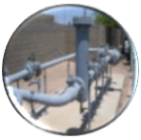
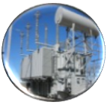
FY 21-22 CIP Projects
Queen Creek Gate Station
Southern Avenue to Country Club Drive Improvements
Residential and Commercial Developments
Substation Improvements
New Electrical Services
Electrical Undergrounding
Notes:
Queen Creek Gate Station - Necessary to meet current development commitments - $2.6M in FY21/22
Southern Avenue to Country Club Drive - $7.3M
Residential and Commercial Developments – Mainly new developments in East Mesa and the Magma District – $4.4M for FY21/22
Substation Improvements – various substation improvements across the City – $800k for FY21/22
New Electrical Services – Mainly for commercial developments - $1.6M for FY21/22
Electrical Undergrounding - $700k for FY21/22

Slide 9
FY 21/22
Proposed
Budget
FY 2022-26
CIP
Funding Source
Utility Revenue Bonds/Obligations
$152.8M
$1.2B
Local Revenues
65.1M
171.2M
General Obligation Bonds
56.7M
221.4M
Joint Ventures
6.7M
48.3M
Grants
6.0M
27.6M
$287.3M
$1.7B
*Does not include budget carryover
*Updated on 5/10/2021
Notes:
Increase from the 4/1 & 4/15 presentation is related to:
Additional $500,000 towards the AMI project for the Electric Outage Management System portion of the project. This is RER Funded.
Additional $3.9M towards the East Mesa Water Interconnect Pipes. We were able to allocate $3.9M in Water Capital Fund as a pool of funding for water planning projects like alignments, environmental studies, etc. Project costs were moved forward a year into FY21-22.

Slide 10
