Slide 1
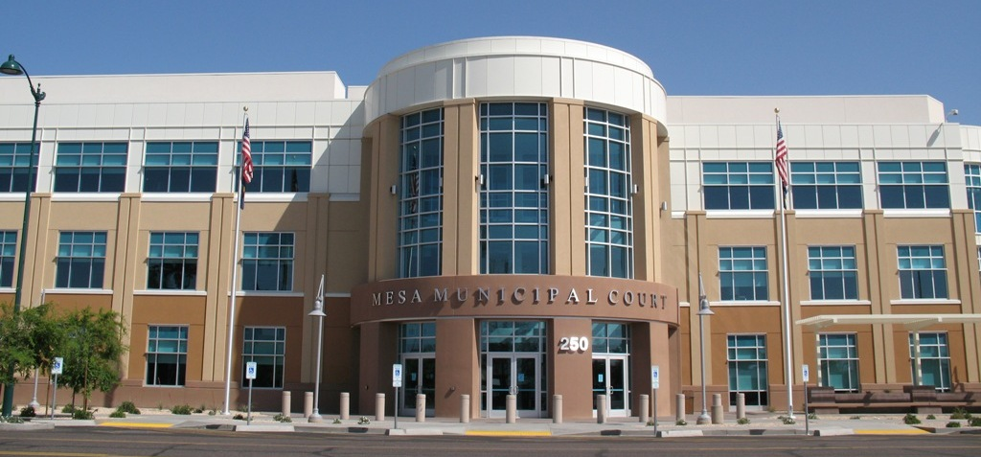
Mesa Municipal Court
FY 21/22 Budget Presentation
1

Slide 2
Mission Statement
As the judicial branch of government, it is our mission to administer fair and impartial justice. We are committed to providing efficient, accurate, consistent and accessible services.
2

Slide 3
FINANCIAL SUMMARY
 | FY 19/20 YEAR END ACTUALS | FY 20/21 REVISED BUDGET | FY 20/21 YEAR END ESTIMATE | FY 21/22 PROPOSED BUDGET
Expenditures
Court Operations | $4,898,048 | $ 6,255,751 | $4,335,040 | $5,806,931
Business Operations | $3,402,445 | $ 3,871,086 | $3,824,260 | $3,491,238
Expenditure Totals: | $8,300,493 | $10,126,837 | $8,159,300 | $9,298,169
Revenues
Court Operations | $ 96,504 | $ 60,000 | $ 60,000 | $ 60,000
Business Operations | $6,944,823 | $8,002,555 | $6,091,669 | $7,584,055
Revenue Totals: | $7,041,327 | $8,062,555 | $6,091,669 | $7,644,055
3

Slide 4
Significant Changes for FY 21/22
Implementation of updated conference bridge system to allow for telephonic hearings.
Reconfigured a courtroom for jury trials.
Implementation of Fines/Fees and Restitution Enforcement (FARE) program.
Defensive Driving School Fee to increase by $10.00.
4

Slide 5
FINES/FEES AND RESTITUTION ENFORCEMENT (fare)
FARE was implemented on February 26, 2021.
Court has not utilized a collection agency for 6 years, since obtaining the new Case Management System (CMS) in 2015.
124,572 backlog cases were sent to FARE.
Potential Enforcement Strategies:
Additional Fees
Delinquency Notices
Vehicle Registration Holds
Intercept Tax Refunds
5
Notes:
The Fines/Fees and Restitution Enforcement (FARE) Program is a statewide initiative of the Arizona Judicial branch. The program was developed in 2003 to assist Arizona courts with the compliance of monetary court orders. Courts are given the ability to assign outstanding debt associated to civil traffic, criminal traffic and criminal violations. The program is a public/private partnership between the Administrative Office of the Courts (AOC), the Motor Vehicle Division, Arizona Department of Revenue and a private vendor.
Enforcement Strategies:
$49.00 Agency Fee
Conduent – Private collections vendor will mail notices
Traffic Ticket Enforcement Assistance Program (TTEAP). Places hold on vehicle registration renewal.
Department of Revenue (DOR): Intercept State taxes and Arizona Lottery winnings.
One benefit of this statewide program is the consistency that it offers.
Individuals get the same fees and same services from the collection vendor.
Which means - no matter where an individual goes within the state, the collections processes are standard from court to court.
Participation in FARE allows the court team to dedicate their time and attention to customer service and other judicial functions.

Slide 6
Defensive driving school fee increase
Increase of $10.00 from $120.00 to $130.00 on April 1, 2021.
Expected increase in revenue in FY 20/21 and FY 21/22 due to fee increase and filings increase.
This revenue goes to the general fund.
An additional $10,000+ per month based on the number of cases resolved by Defensive Driving School in FY 19/20
6
Notes:
DDC a revenue generator (approx. $2mil and some change)

Slide 7
Community court
7

Slide 8
Community court
8

Slide 9
Performance measures
PERFORMANCE MEASURES | TARGET | FY 19/20 | FY 20/21
Abandoned Call Rate | 5% | 11% | 4%
Web Users | 24,000 | 21,000 | 17,000
Interactive Voice Response | 14,000 | 24,000 | 24,000
Time to Disposition | 98% | 98.6% | 96%
9

Slide 10
QUESTIONS?
10

